Slide 1
Monocular Estimation of
Spatial Displacement

Slide 2
Background
Master in Computer Intelligence, UFES (2007-10)
  Depth estimation from monocular images using VG-RAM
Main interests:
  Image processing
    Image normalization
    Feature extraction
  Machine learning
    Model relations among features
    Extract useful knowledge from relations

Slide 3
Background
Ph. D project in U. of Tsukuba (2013-16):
  Robot navigation using monocular image with VG-RAM
Robot navigation
Monocular Image
  Camera image; common, simple, high data throughput
VG-RAM
  Machine learning system
  A kind of weightless neural network
  Used in pattern recognition problems, e.g. face recognition

Slide 4
Background
Monocular images have no explicit structure
  No depth information
  No clear separation between objects
  Susceptible to lighting variations
But they can be approximated using VG-RAM
So we can use them for robot navigation

Slide 5
Topics
Monocular Displacement Estimation
Landmark Extraction
Changes to Images
Displacement Estimation Model
Statistical Analysis
Conclusions
Further Research
Notes:
The remainder of this presentation is divided as follows:
First I describe the problem of estimating physical displacements from monocular images.
Next I define the concept of landmarks, how to extract them...
...and how landmark images are affected by physical displacements in a monocular vision system.
These observations lead to a theoretical model for reasoning about image changes in quantitative terms. I make the hypothesis that it is possible to estimate physical displacement from the apparent changes in landmark images.
Then I present the image data set that was collected to test the hypothesis, and the statistical results obtained from it.
I discuss what conclusions can be drawn from those results,
And finally discuss directions for further research.

Slide 6
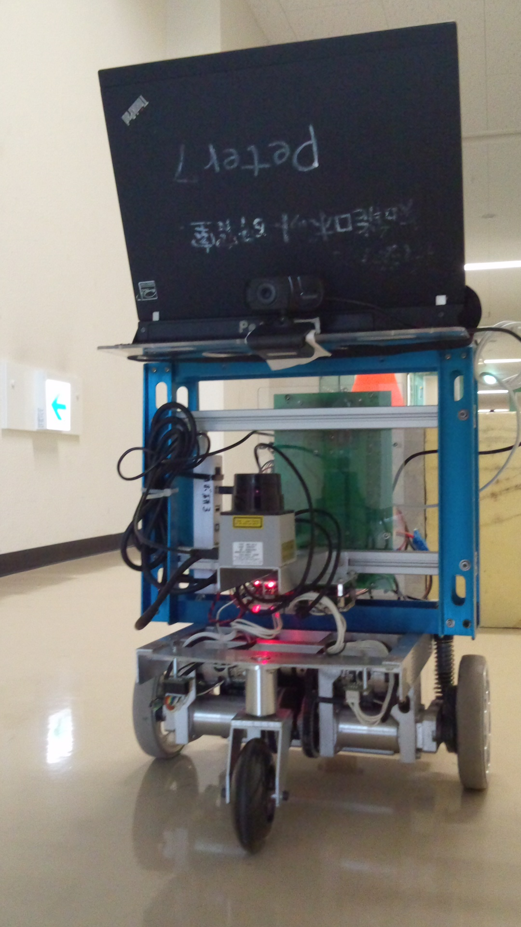
Monocular Displacement Estimation
Robot equipped with monocular camera and odometer
Notes:
Let's consider a mobile robot with a single, front-mounted camera, such as this Yamabiko unit.

Slide 7
Monocular Displacement Estimation
Problem: runaway odometry drift
(x', y', θ')
(Δx, Δy, Δθ)
(x, y, θ)
Notes:
If I set this robot on a straight route, the odometer will probably report a nice regular path like this...
… but the real path, due to accumulated drift errors, will look more like this.
This is the drift problem, I believe you're all familiar with it.
Now, the odometer says where the robot should be.
If I could estimate where the robot actually is...
I could use these two data points to calculate the displacement between the desired and actual locations...
...and use this to get the robot more-or-less back on track.
But how can I know where the robot really is?

Slide 8
Monocular Displacement Estimation
Derive displacement from current and stored sights
Ic
Ir
Ic
Dcr
ML
(Δx, Δy, Δθ)
Ir
F
Notes:
If there is some sort of landmark around the current location...
And I have a picture of this landmark, taken from the position where the robot should be...
I can take another picture of this same landmark from the robot's current location...
Use image processing to filter the differences between these two pictures...
Then feed the differences to a previously-trained machine-learning system...
That will output he displacement between the current and reference images.

Slide 9
Monocular Displacement Estimation
How to select landmarks in pictures?
How to compare landmark images?
How to relate image differences to displacements?
How to design and train the machine learning system?
Notes:
All well and good, but still these problems left unsolved.
On this presentation I'll deal with the first three: how to select...
...and compare landmark images...
...and how to relate differences between images to physical displacements.
We'll leave the question of how to implement the machine-learning system to the next time.

Slide 10
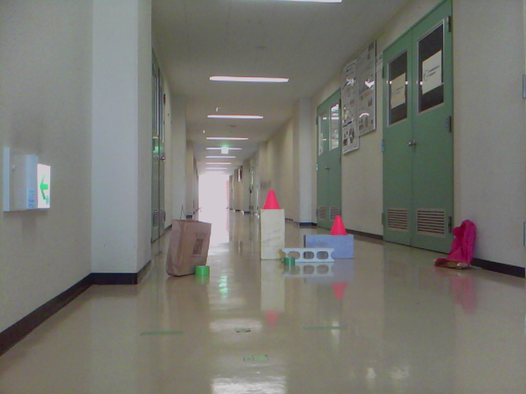
Landmark Extraction
Real-world images often contain stand-out regions
These interest regions can be exploited as landmarks
Notes:
So we are interested in finding "landmarks", but what are landmarks?
In most real-world scenes there are objects that stand-out from the surroundings. They may have a differing color, texture, shape...
I propose that these so-called interest regions be used as landmarks.

Slide 11
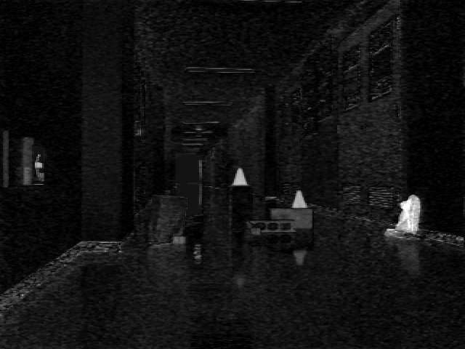
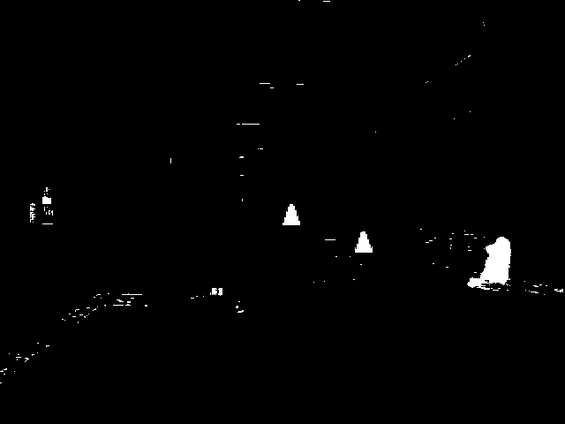
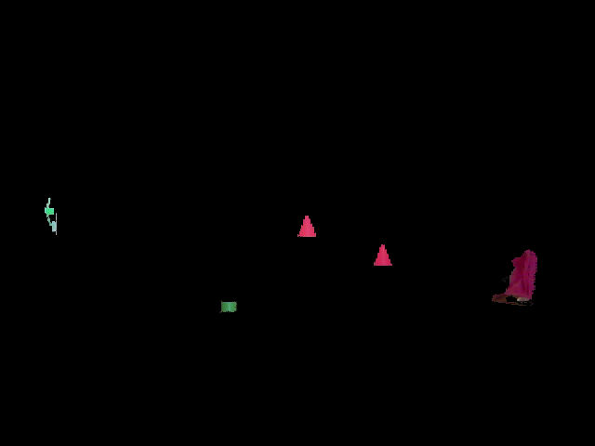
Landmark Extraction
E.g. threshold color saturation
Notes:
Of course we have to define what “stand-out” means in quantitative terms. For preliminary test purposes I defined that an object “stands out” if...
(click)
...its color saturation...
(click)
...is above a certain threshold.
(click)
From this binary mask we can use an image segmentation method – say, watershed...
(click)
...to separate our landmarks from the overall picture.

Slide 12

Landmark Extraction
Landmark images are tagged image-centric attributes:
  Width
  Height
  Horizontal position (U)
  Vertical position (V)
L1
(w, h, u, v)
L3
(w, h, u, v)
L4
(w, h, u, v)
L5
(w, h, u, v)
L2
(w, h, u, v)
Notes:
In order to preserve the spatial relationships among landmark images, each image is tagged with its position in the original picture.
We also add the image's width and height, as a convenience for later comparisons.

Slide 13
Landmark Extraction
Landmark images are collected as a scene
si
L1
(w, h, u, v)
L3
(w, h, u, v)
L4
(w, h, u, v)
L5
(w, h, u, v)
L2
(w, h, u, v)
Notes:
For each picture we define a scene object containing all landmark images extracted from it.

Slide 14
Landmark Extraction
Scenes can be tagged with the robot's position at the time the original picture was taken
si
pi = (xi, yi, θi)
L1
(w, h, u, v)
L3
(w, h, u, v)
L4
(w, h, u, v)
L5
(w, h, u, v)
L2
(w, h, u, v)
Notes:
This makes it easy to associate a landmark image with the position where it was acquired – just tag the scenes with the locations where the original pictures were taken.
Now we have landmark images to match up, explicit attributes to compare, and can even tell where the robot was when they were pictured.

Slide 15
Changes to Images
Changes to landmark images depend on the mode of displacement between the original pictures
  Straight
  Sideways
  Turning
(0, 0, Δθ)
(Δx, 0, 0)
(0, Δy, 0)
Notes:
So let's start matching landmark images and see what shows up. For simplicity, we'll consider changes across three basic displacement modes: straight, sideways, and turning.

Slide 16
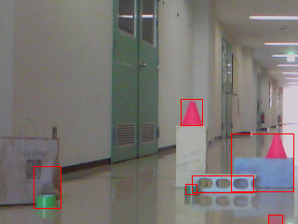
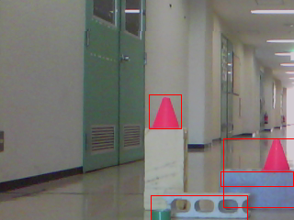
Changes to Images
Straight (forward) displacement
  Landmarks appear bigger as they get close
Notes:
First, for straight displacements, if we switch from the farthest to the closest picture, landmarks seem to get bigger as they get closer (obviously the inverse would be true for backward movements).

Slide 17
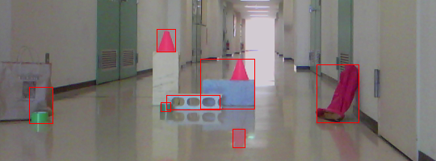
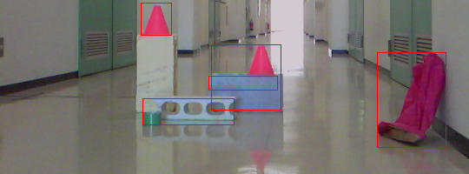
Changes to Images
Straight (forward) displacement
  Landmarks drift towards image borders
Notes:
Landmarks also seem to drift apart, toward the image borders, as they are passed by.

Slide 18
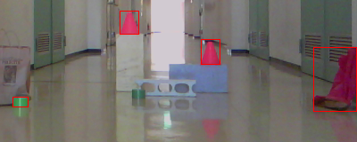
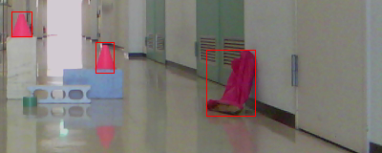
Changes to Images
Turning displacements
  Landmarks slide horizontally across the image
  Size and relative position remain largely the same
Notes:
Whereas for turning displacements, say from left...
(click)
...to right...
(click)
...landmarks seem to slide horizontally, but sizes don't seem to change.

Slide 19
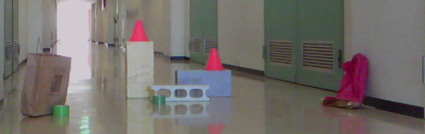
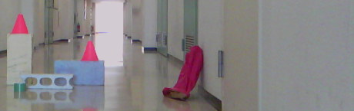
Changes to Images
Sideways displacements
  Landmarks slide horizontally across the image
  Size and relative position remain largely the same
  Overlapping objects move relative to each other
Notes:
Sideways displacements also experience the "sliding" effect found in turning displacements, but there is also a marked parallax effect, as landmarks that are in front of one another seem to change position among themselves.

Slide 20
Displacement Estimation Model
Landmark sightings, and the changes they incur between robot movements, can be represented as sets of four attributes:
  Width
  Height
  Horizontal position
  Vertical position
Changes can be absolute or relative
Notes:
From these observations we can derive a model for reasoning about landmark image changes in quantitative terms.
Landmark sightings (that is, images), as well as changes between them, can be characterized as a set of four attributes: width, height, horizontal position and vertical position. Notice these are attributes of the landmark images, not the actual physical landmarks themselves.
Changes in these attributes can be calculated in absolute and relative terms.

Slide 21
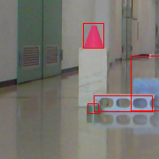
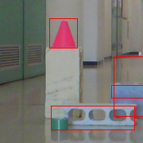
Displacement Estimation Model
Absolute: changes to same landmark across two images
si,a
si,b
(u1, v1)
(u2, v2)
h1
h2
w1
w2
Notes:
Absolute changes are calculated between two sightings of the same landmark.
So for example, in a straight forward displacement, if we have two sightings of the same landmark at times “a”...
(click)
...and “b”...
(click)
...the two sightings will differ across all four attributes, and these changes can be measured like this.
(click)

Slide 22
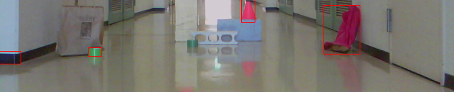
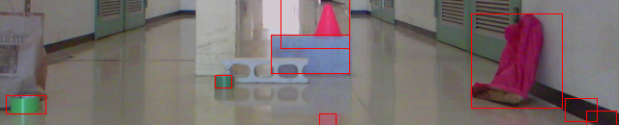
Displacement Estimation Model
Relative: changes to pair of landmarks across two images
si,a
(u'1, v'1)
(u1, v1)
sj,a
h'1
h1
w1
w'1
(u'2, v'2)
si,b
h'2
(u2, v2)
sj,b
h2
w'2
w2
Notes:
For relative changes, the relation between two pairs of sightings is measured across two images.
For example...
(click)
...given two landmark sightings at time “a”...
(click)
… and two sightings of the same landmarks at time “b”...
...we can see that their position relative to each other changes between pictures – they get farther away from each other.
And this kind of change can be measured like this.
(click)

Slide 23
Displacement Estimation Model
The difference between two scenes si and sj is the set of absolute and relative changes to their common landmarks
Dij
Si
Sj
Li1
-
Lj1
= (Δw, Δh, Δu, Δv)1
Li1
Li2
...
Liz
-
Lj1
Lj2
...
Ljz
=
Li2
-
Lj2
= (Δw, Δh, Δu, Δv)2
...
...
pi
pj
Liz
-
Ljz
= (Δw, Δh, Δu, Δv)z
Notes:
Now, given any two scenes...
(click)
...constructed in the manner we saw before, the difference...
(click)
...between them can be defined as the set of changes between their landmarks.

Slide 24
Displacement Estimation Model
The displacement is the change between their positions
Dij
Si
Sj
Li1
-
Lj1
= (Δw, Δh, Δu, Δv)1
Li1
Li2
...
Liz
-
Lj1
Lj2
...
Ljz
=
Li2
-
Lj2
= (Δw, Δh, Δu, Δv)2
...
...
pi
pj
Liz
-
Ljz
= (Δw, Δh, Δu, Δv)z
pi - pj = (Δx, Δy, Δθ)
Notes:
We can add to this representation the displacement...
(click)
...between the positions of the two scenes.

Slide 25
Displacement Estimation Model
The mode is the form of displacement (straight, sideways or turning) between the scenes
Dij
Si
Sj
Li1
-
Lj1
= (Δw, Δh, Δu, Δv)1
Li1
Li2
...
Liz
-
Lj1
Lj2
...
Ljz
=
Li2
-
Lj2
= (Δw, Δh, Δu, Δv)2
...
...
pi
pj
Liz
-
Ljz
= (Δw, Δh, Δu, Δv)z
pi - pj = (Δx, Δy, Δθ)
(St|Tn|Sy)
Notes:
And also the mode of displacement...
(click)
...(straight, turning or sideways) between the scenes.

Slide 26
Displacement Estimation Model
Given a difference between a reference scene si for which pi is known, and a query scene sj, can pj be derived?
Dij
Si
Sj
Li1
-
Lj1
= (Δw, Δh, Δu, Δv)1
Li1
Li2
...
Liz
-
Lj1
Lj2
...
Ljz
=
Li2
-
Lj2
= (Δw, Δh, Δu, Δv)2
...
...
pi
pj
Liz
-
Ljz
= (Δw, Δh, Δu, Δv)z
pi - pj = (Δx, Δy, Δθ)
(Δx, Δy, Δθ) ?
(St|Tn|Sy)
Notes:
This is the model for relating physical displacement to landmark image changes in quantitative terms.
Now the question is, given a reference scene for which position information is known, and a query scene...
(click)
...for which position is not known (so we don't know the mode or amount of displacement)...
(click)
...can we still estimate the physical displacement between those two scenes?

Slide 27
Statistical Analysis
Recorded data: 1300 images of test landmarks
Grid of 10 x 10 stops, 10cm apart
13 takes at each stop, 10° apart
Notes:
The first thing we need to check is whether there is correlation between image changes and displacements. And in order to do that, we need a collection of images with known positions.
Using the Yamabiko robot I showed at the beginning and...
(click)
...a set of test landmarks, I recorded 13 images...
(click)
...taken at spots separated 10 degrees...
(click)
...for each one of 100 positions in front of the landmarks, each 10cm apart, to a total of 1300 images.

Slide 28
Statistical Analysis
Displacement distance (dm) X average change (pixels)
1dm (= 10cm)
X avg(90 positions)
Notes:
Once I had my image database, I extracted the landmark sightings on each one, matched them, and calculated the average changes for each displacement mode.
Changes are averaged over displacement distance.
By this I mean, for example, for straight movements...
(click)
...all changes related to 10cm forward displacements are averaged and shown as a single data point.

Slide 29
Statistical Analysis
Displacement distance (dm) X average change (pixels)
1dm (= 10cm)
X avg(90 positions)
2dm (= 20cm)
X avg(80 positions)
Notes:
Likewise for 20cm forward displacements...

Slide 30
Statistical Analysis
Displacement distance (dm) X average change (pixels)
1dm (= 10cm)
X avg(90 positions)
2dm (= 20cm)
X avg(80 positions)
...
9dm (= 90cm)
X avg(10 positions)
Notes:
...and so on all the way to 90cm displacements.
(click)
Data for sideways and turning movements are grouped by the same logic.
As you can see from these animations, the bigger the displacement, the less valid position pairs there are to analyze.

Slide 31
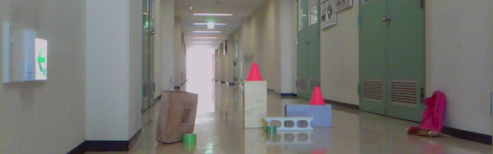
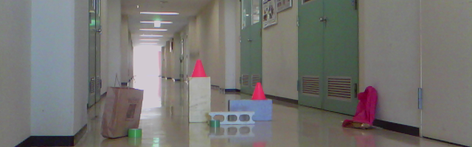
Statistical Analysis
Number of landmark pairs varies (due to occlusion etc)
10° turning (clockwise)
4 landmark pairs
Notes:
Not only that, as displacement increases, valid landmark pairs also get depleted. This is most visible in turning movements.
For example, in this view...
(click)
...we have these...
(click)
...landmarks visible. After a 10-degree clockwise displacement...
(click)
...we have these...
(click)
...landmarks visible. As you can see the leftmost landmark fell out of view. As a result...
(click)
...we have just four landmark pairs from which to measure changes.

Slide 32
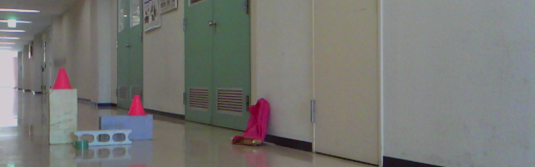
Statistical Analysis
Number of landmark pairs varies (due to occlusion etc)
40° turning (clockwise)
3 landmark pairs
Notes:
Turning 40 degrees from the same initial view, only three landmarks can be related between views.
So as displacement between locations increases, not only we have less location pairs to study, there is also less common landmarks between those pairs from which to get useful information.
Therefore it's important to keep track of the number of valid landmark pairs when plotting the collected data.

Slide 33
Statistical Analysis
Straight displacements
  Displacement (dm) X average change
  Size (Width x Height, normalized my smallest sighting)
  Drift (Change to distance from center)
Notes:
On into the plots.
For straight displacements I'll show two plots, one for average normalized size change – that's the change in area between two landmarks, normalized by the area of the smallest landmark – and another for average drift – that's change in position away from the center of the image.

Slide 34
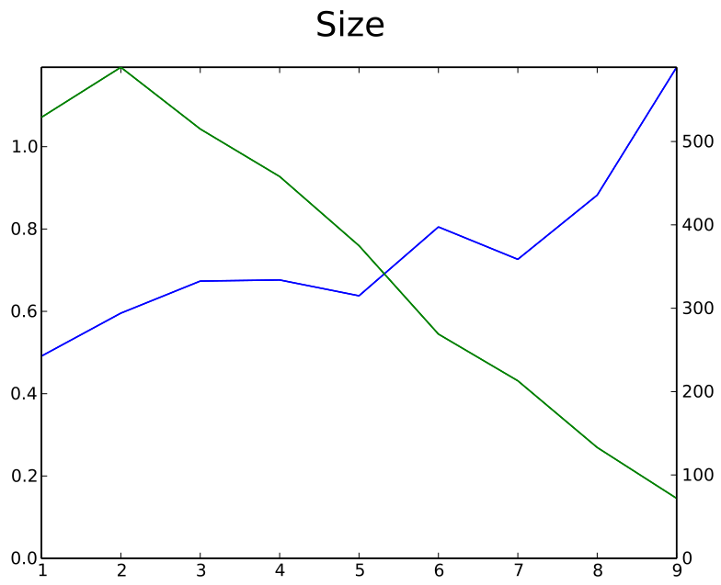
Statistical Analysis
Straight displacements
Average change (rate)
Number of landmark pairs
Displacement (dm)
Notes:
We can see the average absolute size change correlates well to straight displacements, even as the number of valid landmark pairs gets depleted at larger displacements.

Slide 35
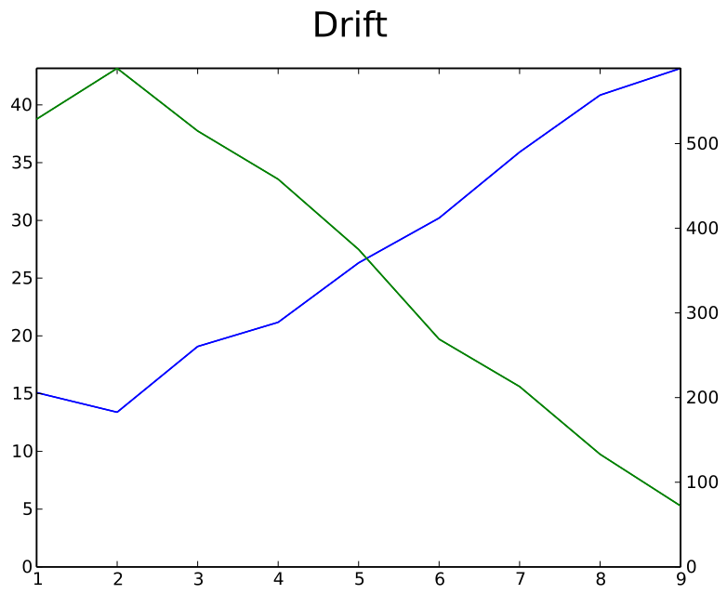
Statistical Analysis
Straight displacements
Average change (pixels)
Number of landmark pairs
Displacement (dm)
Notes:
Drift changes show a strange inverse relation with displacement at short distances, but soon settle into a direct linear relation.

Slide 36
Statistical Analysis
Turning displacements
  Displacement (x 10°) X average change
  Absolute slide (change to horizontal position)
  Relative slide (change relative to other landmarks)
Notes:
For turning displacements the average change over tens of degrees in displacement is shown. I'll show two plots, one for absolute sliding change – that is, how much a landmark seems to slide horizontally from one image to the next – and another for relative sliding – how much a landmark's horizontal position seems to change relative to other landmarks.

Slide 37
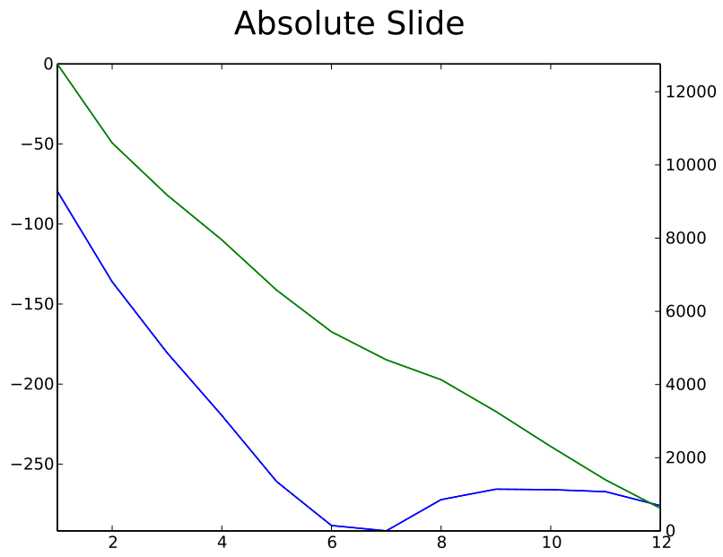
Statistical Analysis
Turning displacements
Average change (pixels)
Number of landmark pairs
Displacement (x 10°)
Notes:
Average absolute sliding shows strong correlation to turning displacement until about 60 degrees. By that point most common landmarks are likely occluded, making results unreliable.

Slide 38
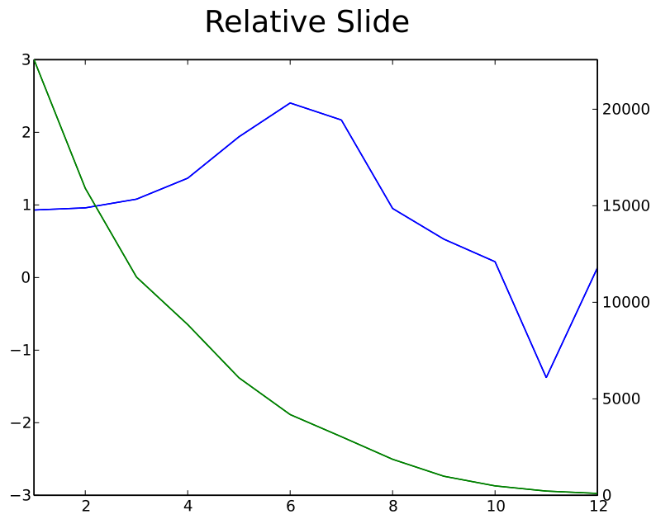
Statistical Analysis
Turning displacements
Average change (pixels)
Number of landmark pairs
Displacement (x 10°)
Notes:
Relative sliding shows landmarks getting increasingly apart from each other, until again at about 60 degrees of difference occlusion makes results erratic.

Slide 39
Statistical Analysis
Sideways displacements
  Displacement (dm) X average change
  Absolute slide (change to horizontal position)
  Relative slide (change relative to other landmarks
Notes:
For sideways displacements the same plots for turning displacements were drawn, except that displacement is again measured in decimeters instead of degrees.

Slide 40
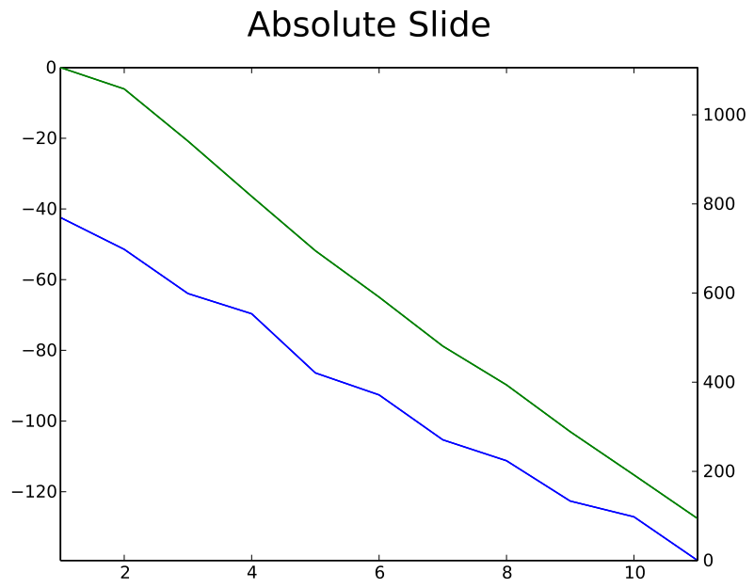
Statistical Analysis
Sideways displacements
Average change (pixels)
Number of landmark pairs
Displacement (dm)
Notes:
Because occlusion is a less serious problem for sideways displacements than it is for turning displacements, the average change for absolute sliding remains strong correlated to displacement all the way.

Slide 41
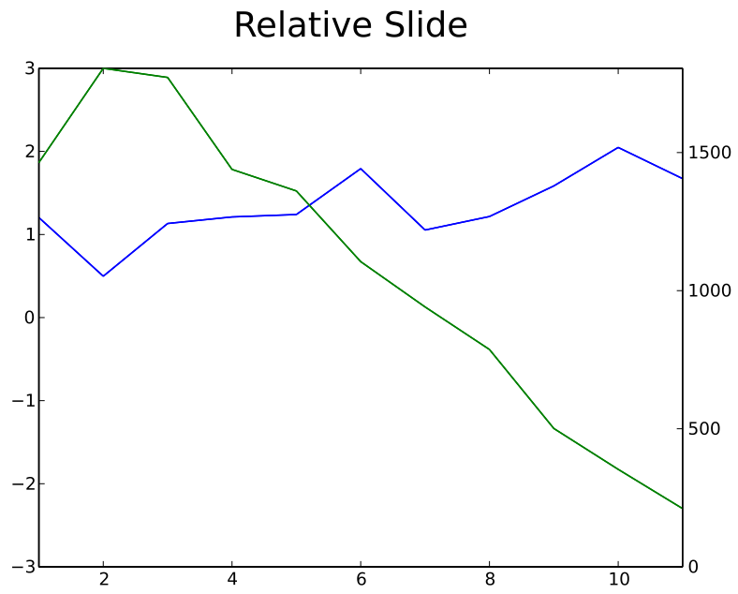
Statistical Analysis
Sideways displacements
Average change (pixels)
Number of landmark pairs
Displacement (dm)
Notes:
Average relative sliding shows a characteristic oscillating pattern, caused by the parallax effect as landmarks sliding past each other.

Slide 42
Conclusions
Sighting size and position changes correlate well to straight movements
Sighting horizontal position changes correlate well to sideways and turning movements
Differences in relative changes can be exploited to tell apart sideways and turning movements
The feasibility of estimating robot displacement from landmark sighting changes is not to be ruled out

Slide 43
Further Research
Methods for selecting landmarks
Larger / more varied image data base
Apply machine learning methods (e.g. WNN)
Notes:
From now on, what I intend to look into are
better ways to select and compare landmarks,
Increase the size and diversity of the image data base,
And experiment with machine-learning methods to actually estimate individual physical displacements from landmark changes.

Slide 44
The End
Source code, data files and article contents available at: http://github.com/xperroni/Yamabiko/tree/master/2013-3
Questions?
Notes:
This is the end of my presentation. By the way all files and source code of the programs used in this research are available at this URL.
Do you have any questions?

